Slide 1
Panda’s Travel
Lesson 7

Slide 2


Review
Notes:
2

Slide 3
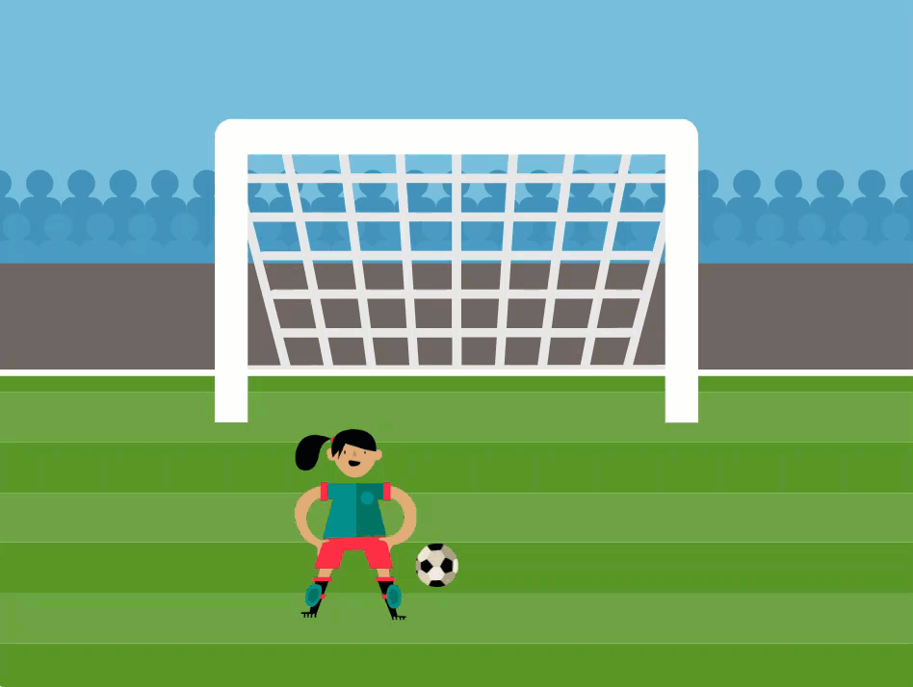

Slide 4

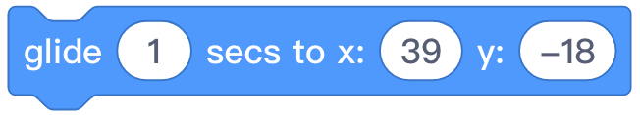


Review
Blocks | Function
Control the sprite to change its costume into the specified costume.
Moves smoothly to a specified position at the stage in a specified time.
Display the sprite
Hide the sprite

Slide 5


Slide 6
Hands On

Slide 7
Bounce and Rotation

Slide 8
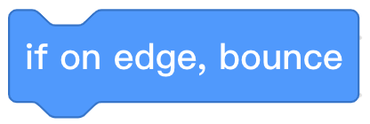

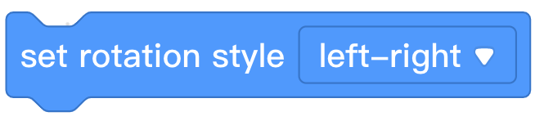
Programming Knowledge
Block Area | Block | Function
If the sprite touches the edge of the stage, it will “bounce” and move in the opposite direction.
Set the rotation style of the sprite.

Slide 9
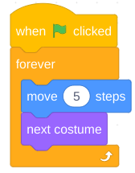
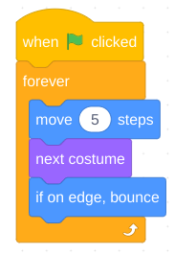
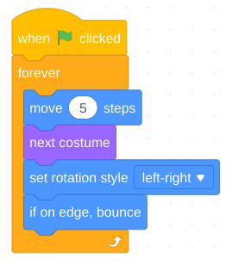
Compare and Contrast
Program #1 | Program #2 | Program #3

Slide 10

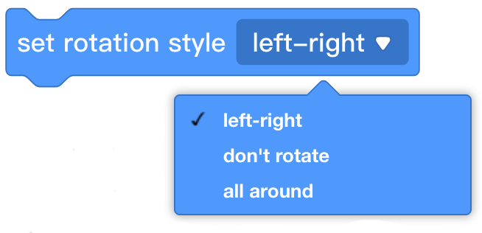
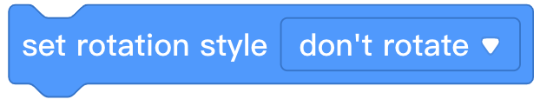
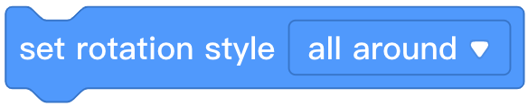
There are three rotation ways. Why not try the effect of the
other two ways?
Notes:
10

Slide 11
Game Time

Slide 12
Conditionals Game
Obey the commands of your teacher.

Slide 13
Conditional Statements

Slide 14
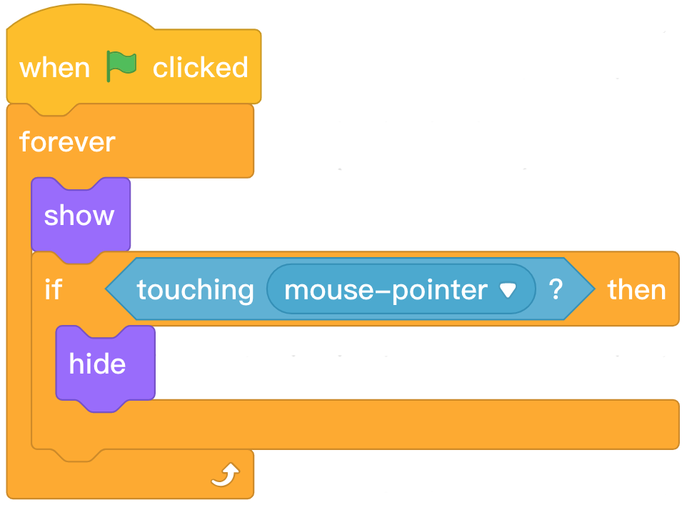
“Conditional"
Used to perform specific actions if a condition is true.

Slide 15
Program Description
Start the program.
Show the sprite.
Check if the condition is true.
If the condition is true, run the code inside the conditional block.
Repeat steps 2 & 3 until the program is stopped.

Slide 16

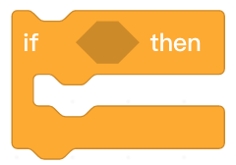
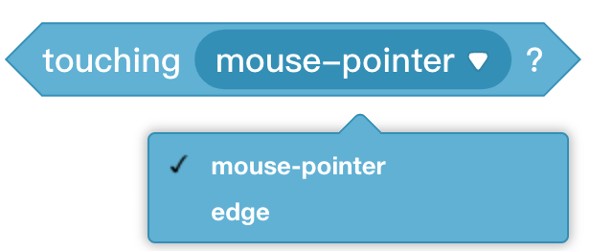

Programming knowledge
Block area | Block | Function
Conditional statement that checks whether a condition is met. If the condition is met, then proceed to execute the sequential action.
Sensing block used in a conditional statement to determine if a condition is met.

Slide 17

Step 1: Find and select the appropriate blocks from the Block Area to create the following program.
Step 2: Click the in the Stage Area. Move the mouse pointer back and forth over Panda to observe the effect of the program.
Step 3: Describe what happens when the mouse is moved around the stage.

Slide 18
Loops & Conditional Statements

Slide 19
Program Description
Start the program.
Show the sprite.
Check if the condition is true.
If the condition is true, run the code inside the conditional block.
Repeat steps 2 & 3 until the program is stopped.
This program always or repeatedly checks if the condition is true. The blocks inside the conditional statement may run more than once.

Slide 20
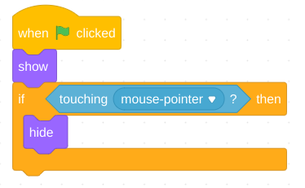
Program Description
Start the program.
Show the sprite.
Check if the condition is true. If the condition is true, run the code inside the conditional block.
Stop the program.
This program only checks once, immediately when the program starts, if the condition is true. The blocks inside the conditional statement may run up to one time if the mouse pointer is touching the sprite when the program is started.

Slide 21
Let’s try!

Slide 22

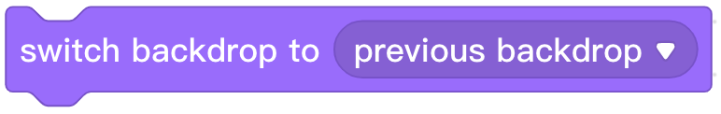
Changing a Stage Background

Slide 23
Independent Practice
Parrot’s Travel
Requirements:
Trigger Panda to walk across the stage (while changing costumes).
Program Panda to turn around instead of walking off the edge of the stage. Make sure Panda doesn’t turn upside down.
If Panda touches the edge, change the backdrop to a new location. Showcase at least 5 different locations Panda has visited.
Set a starting position for Panda.
Set a starting backdrop.

Slide 24
Extension
Challenge students with remaining time to do one or more of the following:
Add a new sprite to create a title for Panda’s Travels slideshow.
Program Panda to say the location when the backdrop changes.
Add a friend who traveled with Panda to all of the locations.
Notes:
24

Slide 25
Review

Slide 26
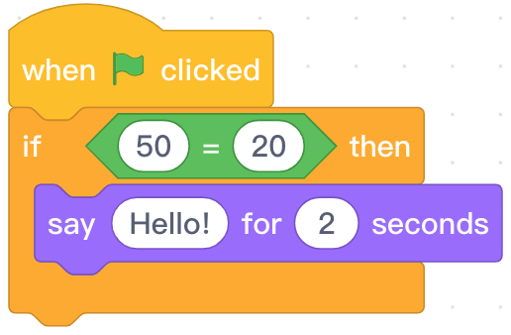


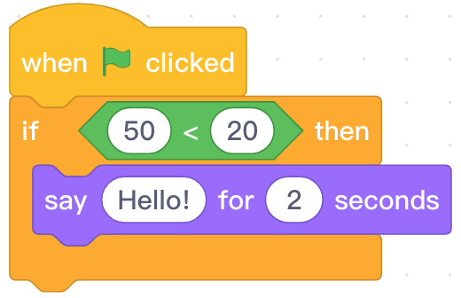
1. Which of the programs below can make the character to speak “Hello” for 2 second?
A.
B.
C.
D.

Slide 27
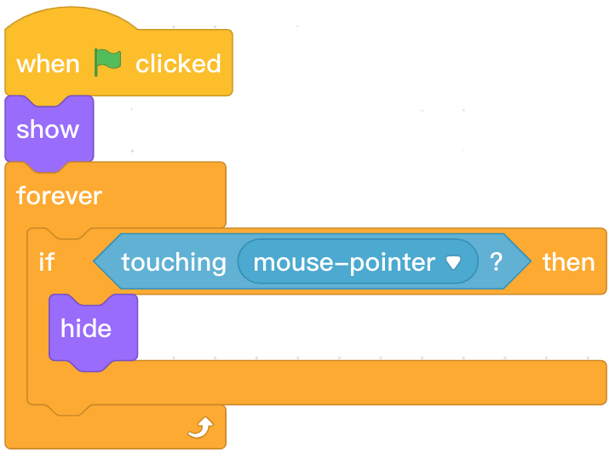
2. What condition needs to be met to make the sprite disappear?
A. When the green flag is clicked
B. When the role touches the mouse pointer
C. When the stage touches the mouse pointer
D. When blocks touch the mouse pointer
Notes:
27

Slide 28




3. What’s the shape of conditional block?
A.
B.
C.
D.
Notes:
28

Slide 29
Thank you!

